Slide 1
Awards & Opportunities Committee
FOCUS Awards for Advancing Women in Academic Medicine
Orientation

Slide 2
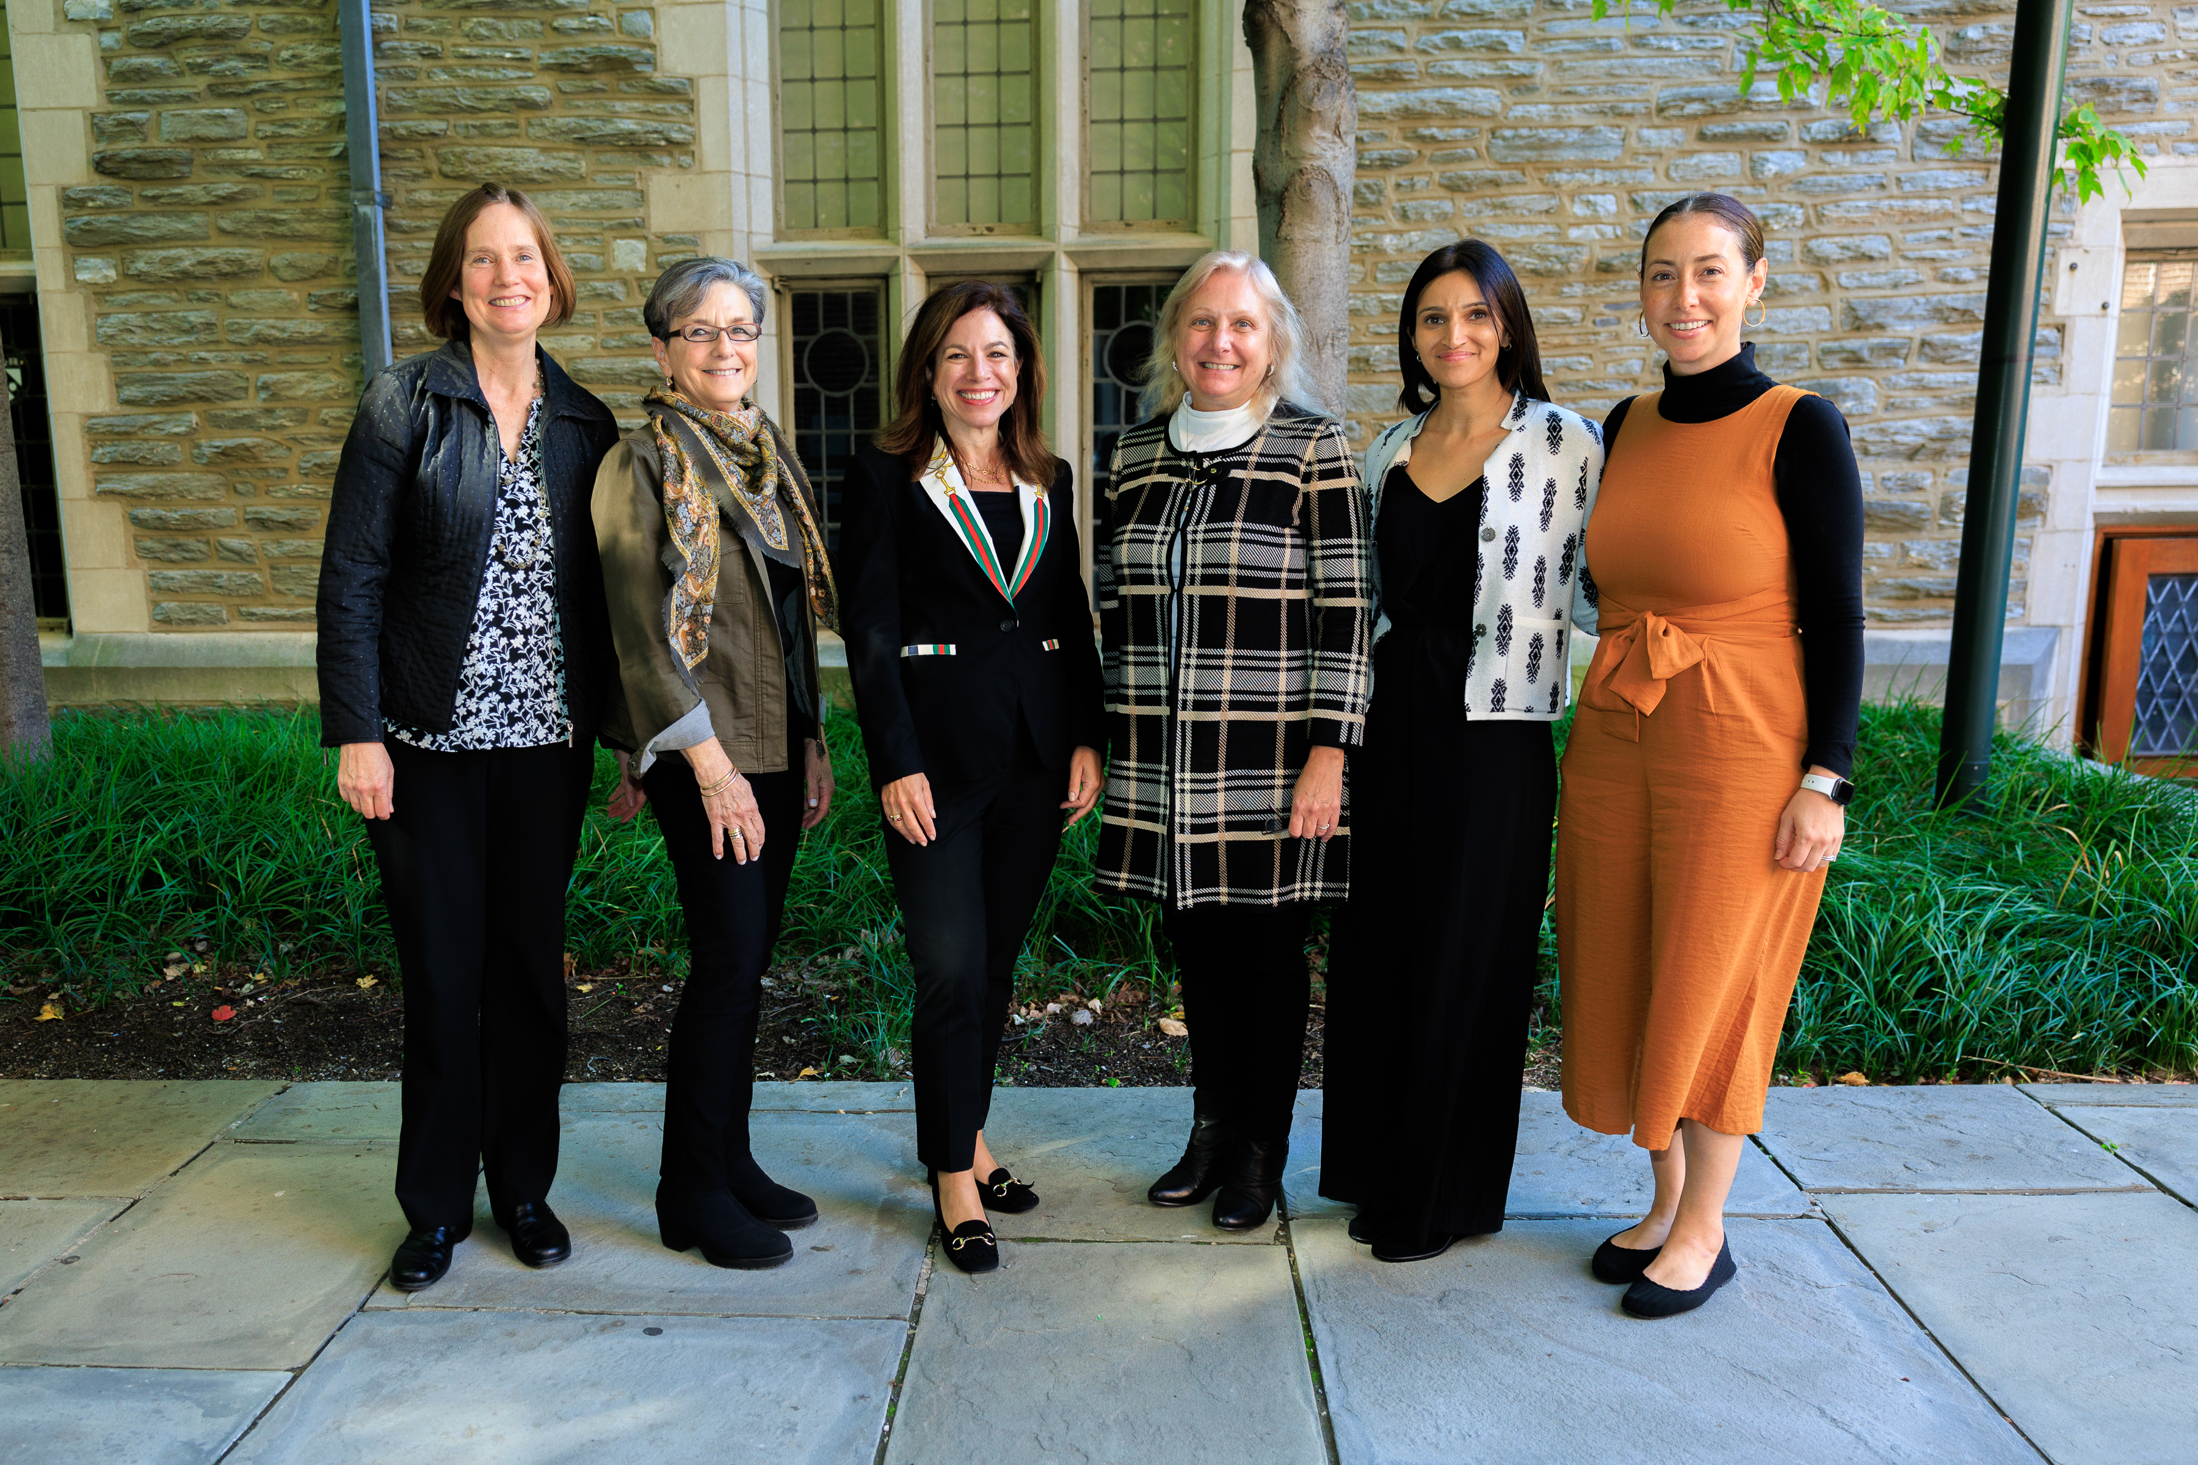

Slide 3
FOCUS Award History
FOCUS mentoring award (1999-2003)
In 2004, the award became one of the School of Medicine Awards of Excellence, the Arthur K. Asbury Award for Outstanding Faculty Mentoring
FOCUS Award for the Advancement of Women in Medicine (2004-present)
FOCUS Early Achievement Award for the Advancement of Women in Medicine (2023-present)

Slide 4
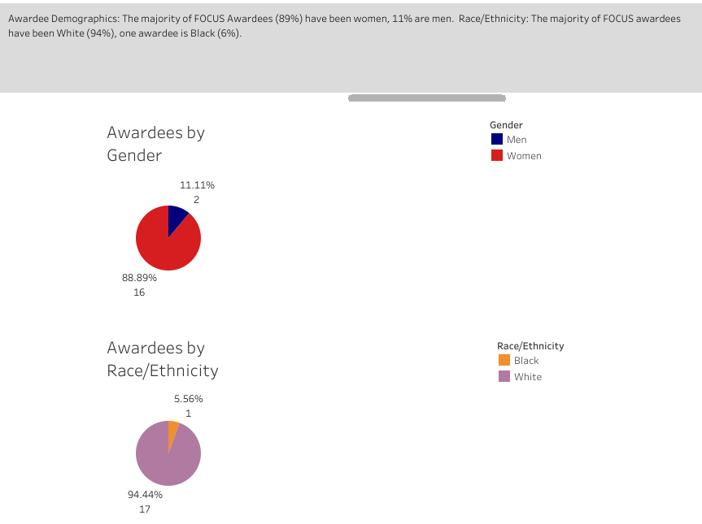
FOCUS Award History

Slide 5
FOCUS Award Redesign
Began summer of 2023
Extensive literature review
Recommendations in the following areas based on a review of the literature
Nominee pool
Review committee
Award selection criteria
Review and deliberation process
Notes:
Nominee pool: To-date, the majority of our nominees have been White (82%), followed by faculty who are Black (7%) and Asian (4%). 1) We will direct calls for nominations to all PSOM faculty and to Department Chairs, Vice Chairs of DEI, Vice Chairs for Faculty Affairs, OIDE, Alliance of Minority Physicians and other groups to diversify our nominee pool. 2) We will publish our award rubrics on our website and include them with the call for nominations, advising nominators to align their nomination letter with the award rubric. 3) We will give nominators more time to prepare materials – considering holidays and important deadlines – changing our timeline from announcing the call for nominations to nomination due date from 1 month to 3 months.
Review Committee: 1) We have changed the committee structure from consisting of prior awardees which can perpetuate demographics of successive prize winners, to a group of faculty diverse in gender, race/ethnicity, rank, track, career paths, specialty and experience. 2) We will establish 3 separate review committees, one for the early achievement award, one for the senior award and one for the ELAM and ELH nominations. This allows committee members enough time to thoughtfully review each nominee. 3) We have implemented an ad hoc committee structure where committee members change every 2 years, this distributes opportunities for service across a greater number and diversity of faculty and supports a changing diversity of perspectives and experiences that can enrichen the evaluation process. 4) We will ask for each committee to have a committee chair who will act as the DEI champion to ensure DEI is considered in all aspects of the committee’s work. 5) We will publish the membership of the review committees on our website to increase transparency.
Award Selection Criteria: We have designed FOCUS awards rubrics for the Early Achievement and Senior faculty FOCUS awards to create a measure by which to evaluate each nominee using consistent criteria. The rubric also serves as a tool to ensure that committee decisions and discussions link the evidence presented in the nomination packet to the defined selection criteria. The rubrics will be shared in our call for nominations and will be published on our website.
Review and Deliberation Process:
Review/Pre-assembled committee deliberation
1) We will randomly sort the nominees when sending committee members their nomination packets so that each committee member reviews the nominees in a different order. This prevents presentation bias by ensuring that every nominee gets seen early by some committee members and later by others. 2) We will ask each committee member to make a personal list of their top 3 nominees before hearing the recommendations of others to avoid undue influence. These rankings will be anonymous, we will ask you to send your top 3 nominees, in no particular order, to Sue Primavera who will share the aggregated list of top nominees with the committee chair.
Formal, convened deliberation
3) In addition to top nominees, the committee chair will invite any committee member to speak to additional names that they feel should be elevated to the shortlist for group discussion. 4) We will have a set protocol for discussing nominees in the convened meeting. 5) The committee chair will ensure that committee decisions and discussions link the evidence presented in the nomination packet to the defined selection criteria. 6) A member of the FOCUS team will document selection and decision-making processes.

Slide 6
FOCUS Award Rubric – notes to reviewers
Goal of the award: The FOCUS Award for the Advancement of Women in Medicine recognizes a faculty member (of any gender identity) who has shown role model-level excellence in paving the way for women across the continuum in academic medicine at the PSOM or beyond in areas including any or all of the following domains: advocacy, structural change, mentorship, sponsorship, education, science, clinical care and administration.
Mitigating bias: In efforts to mitigate the influence of personal experience with or feelings towards any one nominee, please evaluate each nominee based solely on the materials in their nomination packet.
Confidentiality: Nomination packet materials and deliberations are confidential and should not be shared with individuals outside of the FOCUS Awards and Opportunities Committee.
Reporting conflicts of interest: There may be nominees whom the committee members know socially, have worked with, published with etc. FOCUS does NOT request that committee members recuse themselves on all such cases. If you feel that you cannot comment objectively on a nominee, we assume that you will recuse yourself from evaluating that nominee.
Completing the rubric: For each area of excellence, please rate the level of impact from 1 to 5 (1 = lowest impact, 5 = highest impact) and note examples of this impact drawn from the nomination packet (this is required). Scope of one’s impact may be noted as well (individual, divisional, departmental, the PSOM, University, beyond Penn)
Creating a list of top nominees: Once you have reviewed the nomination packets and completed the scoring rubrics for each nominee, please make a list of your 3 top nominees. Your top nominees do not need to be positioned in any particular order. Please send your list of top 3 nominees to Sue Primavera at sprimave@pennmedicine.upenn.edu who will share an anonymized aggregation of top nominees to share at the assembled deliberation.

Slide 7
FOCUS Award Rubric
Nominee’s Name: ____________________________________ Total Impact Score: _________________
Domains | Level of Impact Score (1-5) 1 = lowest 5 = highest | Rationale for impact score (examples from the nomination packet are required)
Paves the way for women in academic medicine through advocacy, structural changes, mentorship and/or sponsorship
Generates improvements for women through education, science, clinical care and/or administration

Slide 8
Examples of impact scoring
Domains | Examples | Impact Score 1 | Impact Score 5
Paves the way for women in academic medicine through advocacy, structural changes, mentorship and/or sponsorship | Creation of career development/leadership programs, networking/mentoring opportunities, number of mentees/protégés Policy changes / changes in systems that enhance the work environment and culture for women as a result of advocacy, at the division, department, school, regional, national levels Promotion of women colleagues to achieve awards, opportunities, special recognition, promotions, leadership positions Roles in mentorship/sponsorship structures (formal or informal) for trainees | Minimal evidence of positive impact on mentees, protégés, patients, peers, colleagues, or environment Letters/CV provide few examples/outcomes | Substantial evidence of positive impact on mentees, protégés, patients, peers, colleagues, or environment Letters/CV provide specific examples of change in outcomes as a direct result of applicant’s efforts Internal or external recognition of accomplishments in these domains by professional societies or other such organizations
Generates improvements for women through education, science, clinical care and/or administration | Creation of, or leadership in, educational programs that help the advancement of women in science and medicine Creation of, or leadership in, clinical programs specific to women’s health Creation of, or leadership in, research that impacts the health and wellbeing of women Creation of, or leadership in, administrative changes supporting women in academic medicine/scholarship focused on women in the workforce | Minimal evidence of positive impact on mentees, protégés, patients, peers, colleagues, or environment Letters/CV provide few examples/outcomes | Substantial evidence of positive impact on mentees, protégés, patients, peers, colleagues, or environment Letters/CV provide specific examples of change in outcomes as a direct result of applicant’s efforts Internal or external recognition of accomplishments in these domains by professional societies or other such organizations Regional / national recognition as a scholar in these domains

Slide 9
Questions/Feedback
PROCESS QUESTIONS/FEEDBACK
Bridget Dougherty, MPH (on maternity leave May – September 2024) - bridget.dougherty2@pennmedicine.upenn.edu
Mira Mamtani, MD, MSEd - mira.mamtani@pennmedicine.upenn.edu
Cori Schreiber, MD, MPH - cschreiber@pennmedicine.upenn.edu
ADMINISTRATIVE QUESTIONS
Sue Primavera - sprimave@pennmedicine.upenn.edu

Slide 10
References
University of Calgary, Equity, Diversity and Inclusion (EDI) in Research and Training Awards Guide
University of Michigan, Managing internal nomination and peer review processes to reduce bias, 2021
Society for Industrial and Applied Mathematics, Guidelines on SIAM Prize and Recognition Committee Formation and Processes, 2023
Mathematical Association of America, Guidelines for MAA Selection Committees: Avoiding Implicit Bias, 2017
Carpenter, J, Mayfield, B, Su, F. Check Your Bias: Using Inclusive Selection Practices. 2021
Society for Industrial and Applied Mathematics, Guidelines for Selection Committees, 2023
Bauer & Baltes, 2002
American Chemical Society, Selection Committee Best Practices
Greenwald, A. G.; Nosek, B. A.; Banaji, M. R. Understanding and Using the Implicit Association Test: I. An improved scoring algorithm. Journal of Personality and Social Psychology 2003, 85, 197-216.
Moss-Racusin, C. A.; Dovidio, J. F.; Brescoll, V. L.; Graham, M. J.; Handelsman, J. Science faculty’s subtle gender biases favor male students. Proc. Natl. Acad. Sci. USA 2012, 109 (41), 16,474-16,479.
Project Implicit, https://implicit.harvard.edu/implicit/takeatest.html.
Establishing a Fair Process for Selecting ACS Award Winners,
http://www.acs.org/content/dam/acsorg/funding/awards/national/establishing-a-fair-process.pdf
Workshop on Building Strong Academic Chemistry Departments Through Gender Equity, http://www.acs.org/content/dam/acsorg/funding/awards/national/gender-equity-report-cover.pdf
Geochemical Society & European Association of Geochemistry, Award Committee Best Practices
American Mathematical Society, Prize Committee Best Practices

